Slide 1
Apprenticeships
National Apprenticeship Week

Slide 2
What are they?
Apprenticeships are a way to continue learning and gaining more qualifications after you leave school, either at 16 or at 18, or even when you are much older!
They are a way of working and learning, with the majority of your time spent working for the company.
The company pays for your training and qualifications.
20% of your time is set aside for training.
And yes- you get paid for the work you do!

Slide 3
Let’s find out more about apprenticeships

Slide 4
Local and National opportunities
Local training providers
Crawley College and East Surrey College
Plumpton College
Steve Willis Training
Rewards Training
Local and multinational companies

Slide 5
What levels are there?
There are different levels for different careers and for students with different grades at GCSE or A-Level
L2 Intermediate (generally when leaving year 11)
L3 Advanced (often when leaving after year 11 or Sixth form)
L4-5 Higher Apprenticeships
L6 Degree apprenticeships (after securing good A-Levels or L3 qualifications)
L7 Degree Apprenticeship (equivalent to a Masters)

Slide 6
What kind of jobs can I get an apprenticeship in?
What first springs to your mind?
What if I told you that you could be lucky and get an apprenticeship in almost anything! There are even now Medical Doctor degree apprenticeships!

Slide 7
Money Money Money! How much can I earn?
How much can I earn?
16 -18 years old
£6.40
That’s not much!
remember though, the company are investing in you, paying you and paying for your training.
18+ and taking on a higher or degree apprenticeship can earn much more!

Slide 8
Money, Money, Money!
How much can I earn 18 +?
If you get good A-Levels or L3 qualifications like BTECS, you can apply for Advanced, Higher and Degree Apprenticeships.
The wages for these vary, but I am sure you will be surprised how much you can earn as an 18 year old.
Degree
£22,500
Engineering
Degree
£24,375
Digital Marketing
L6 Degree
£25,988
Food industry Technical professional
L7 Degree
£27,000
Solicitor
Degree
£28,808
Civil Engineering
What is the most Mr Svoboda has seen for an 18+ apprenticeship?

Slide 9
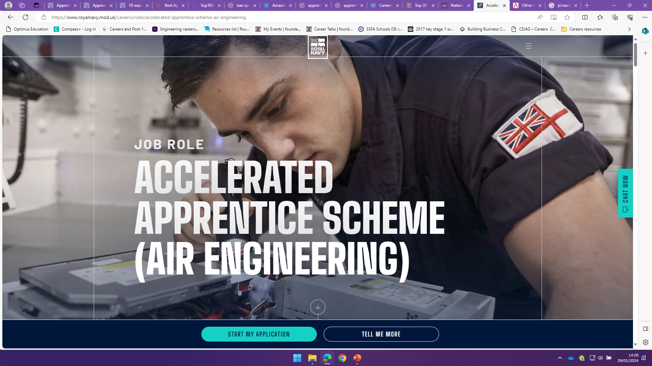
The Royal Navy-£39,974- £62,000

